Slide 1
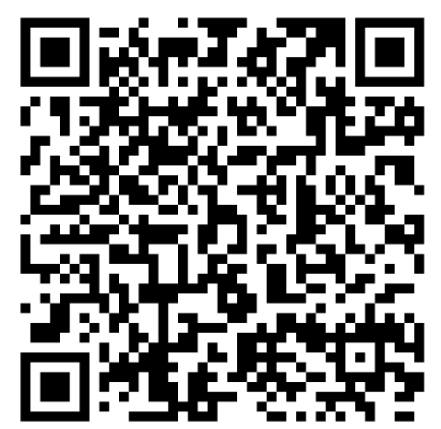
Go to this GitHub Repository/Branch for our Smart Contract and Test Scripts, and be sure to check out the README – there are important commands and instructions at the bottom:
https://github.com/RaymondLapointe/WealthPixels-Labs-Sandbox/tree/firebase

Slide 2
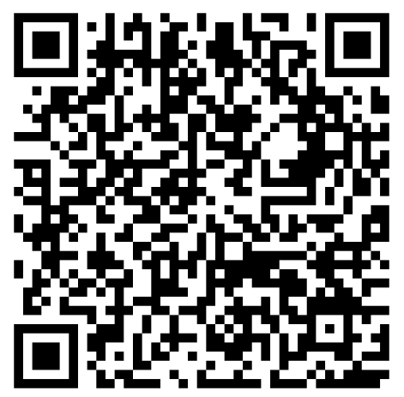
Go to this GitHub Repository for our Front-end code and APK file (app-debug.zip), and be sure to check out the README:
https://github.com/RaymondLapointe/WealthPixels-Labs-Frontend

Slide 3
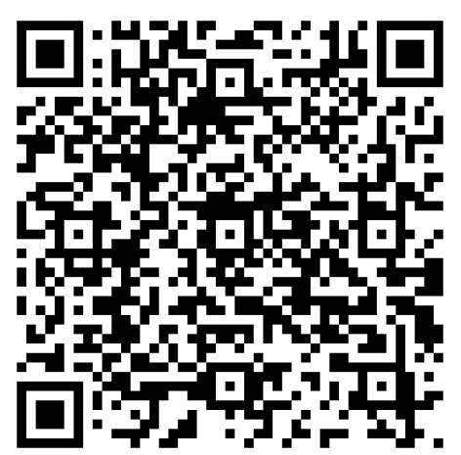
Go to this GitHub Repository/Branch to see how we were attempting to integrate Chainlink Data Streams, and be sure to check out the README:
https://github.com/RaymondLapointe/WealthPixels-Labs-Sandbox/tree/datastream

Slide 4
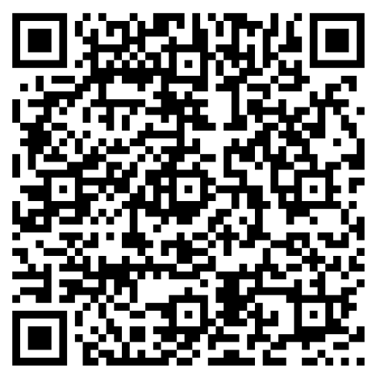
Go to this GitHub Repository find out more about the vision for this project:

